Slide 1
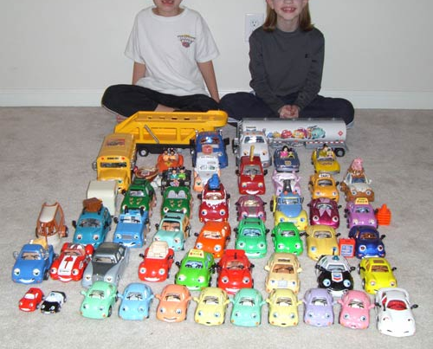
Datasets

Slide 2

Datasets and Powers of 10
DATASETS AND

Slide 3
0
10
images

Slide 4
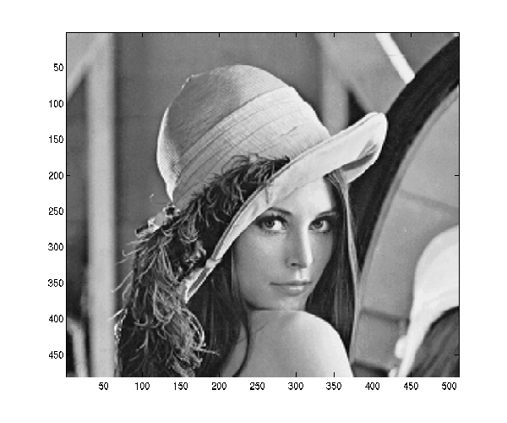
0
10
images
1972
Notes:
We can know every pixel, we even know the person
As the dataset increases, we lose local accuracy in the description but we improve the generalization

Slide 5
1
10
images

Slide 6
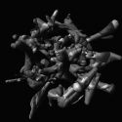
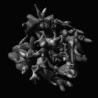
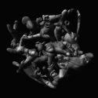
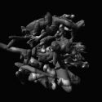
The Camouflage Challenge
1
10
images
To write an algorithm that takes the training images as input and then recognizes and segments objects in the test set
The training set consists of 20 images of 9 objects. Each image has a novel camouflage albedo texture map, and a novel background of other digital embryos, also with a novel arrangements and camouflage patterns. The target object is in front, i.e. "in plain view".
For quantitative tests, there is also a test set that consists of 20 images of 9 objects. Each image is generated as with the training set.
Brady, M. J., & Kersten, D. (2003). Bootstrapped learning of novel objects. J Vis, 3(6), 413-422

Slide 7
1
10
images

Slide 8
2-4
10
images

Slide 9
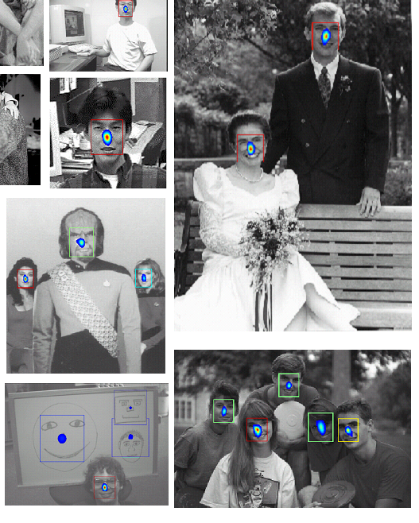
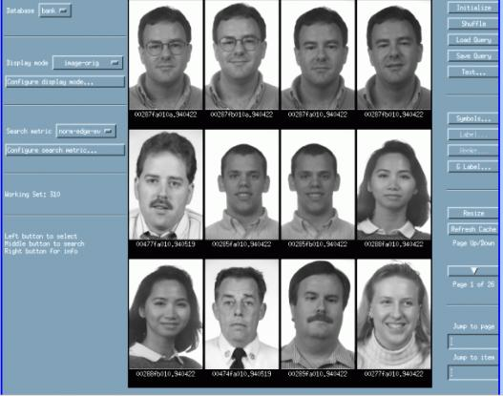
The faces and cars scale
2-4
10
images
In 1996 DARPA released 14000 images, from over 1000 individuals.

Slide 10
2-4
10
images

Slide 11
5
10
images

Slide 12
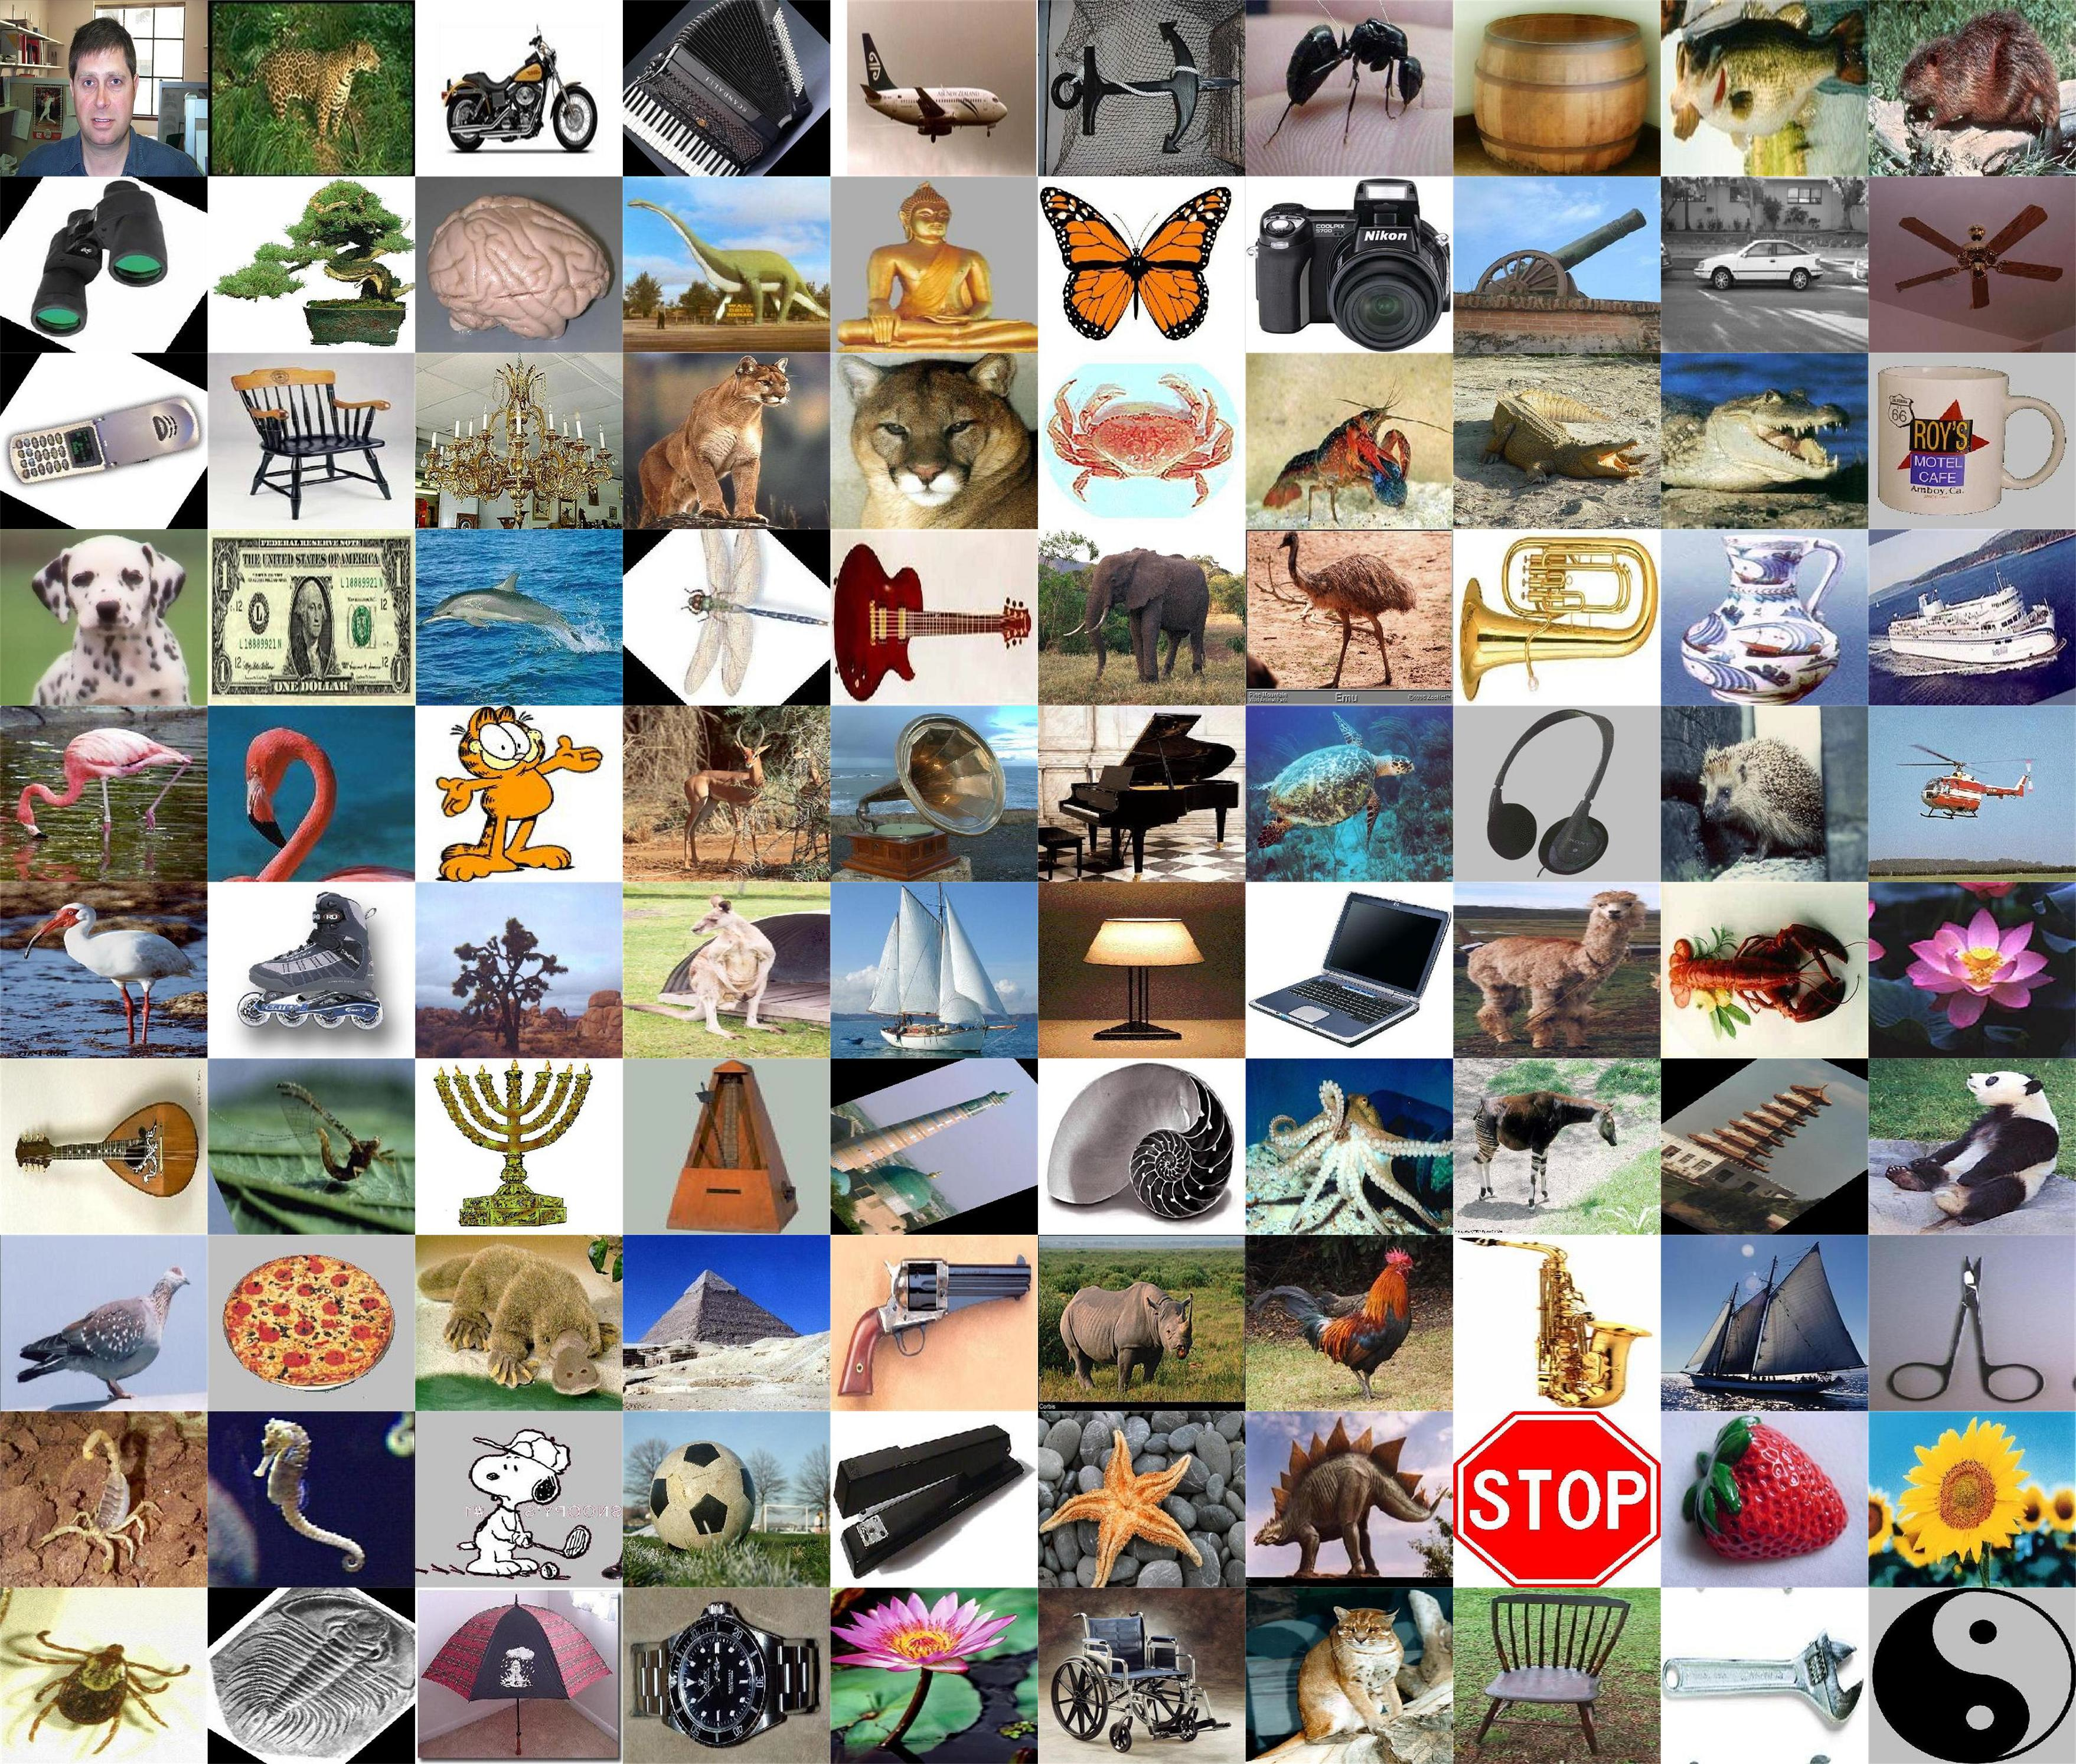
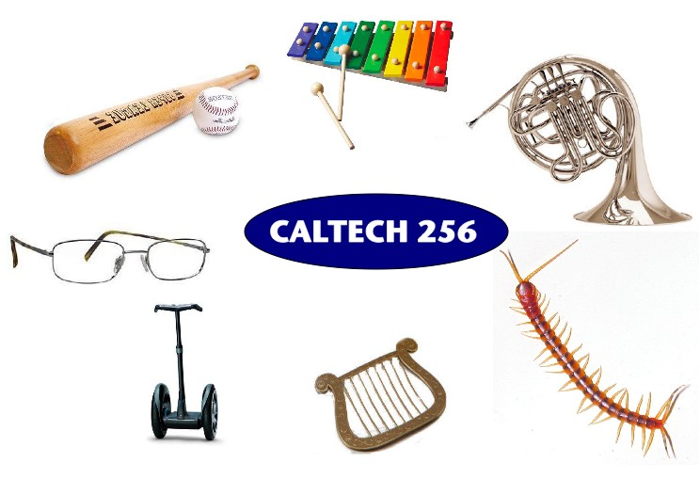
Caltech 101 and 256
5
10
images
Griffin, Holub, Perona, 2007
Fei-Fei, Fergus, Perona, 2004

Slide 13
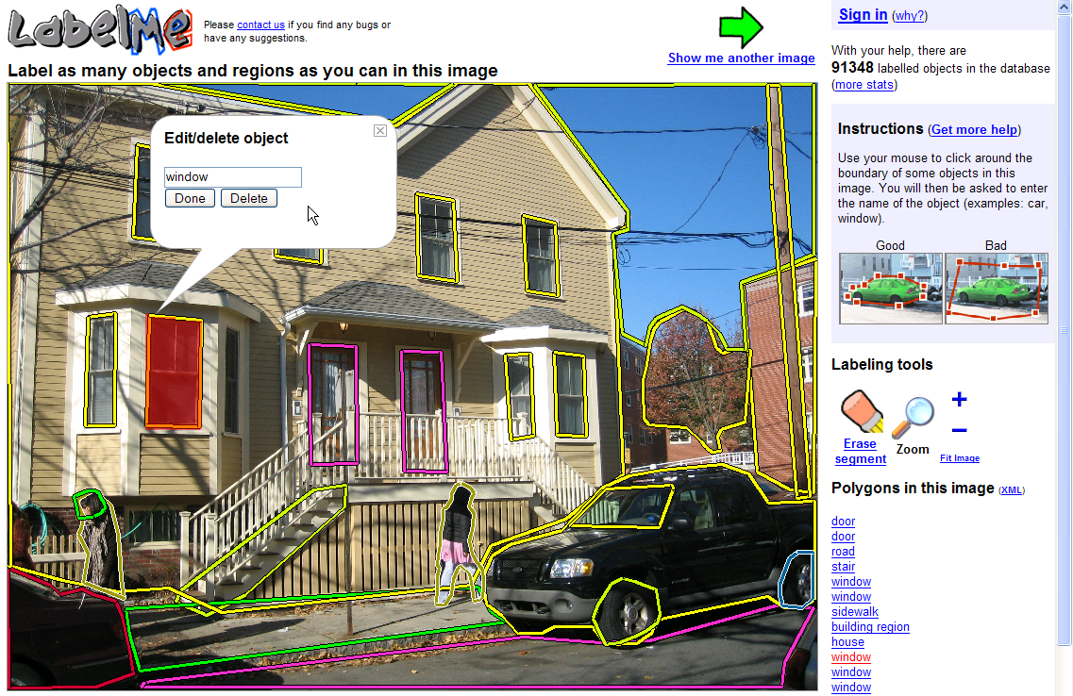
5
10
LabelMe
images
Russell, Torralba, Freman, 2005

Slide 14
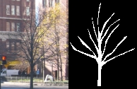


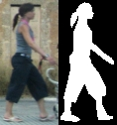


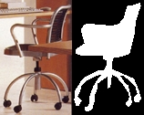
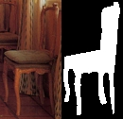
Extreme labeling
Notes:
14

Slide 15
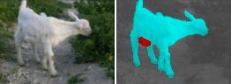

Slide 16
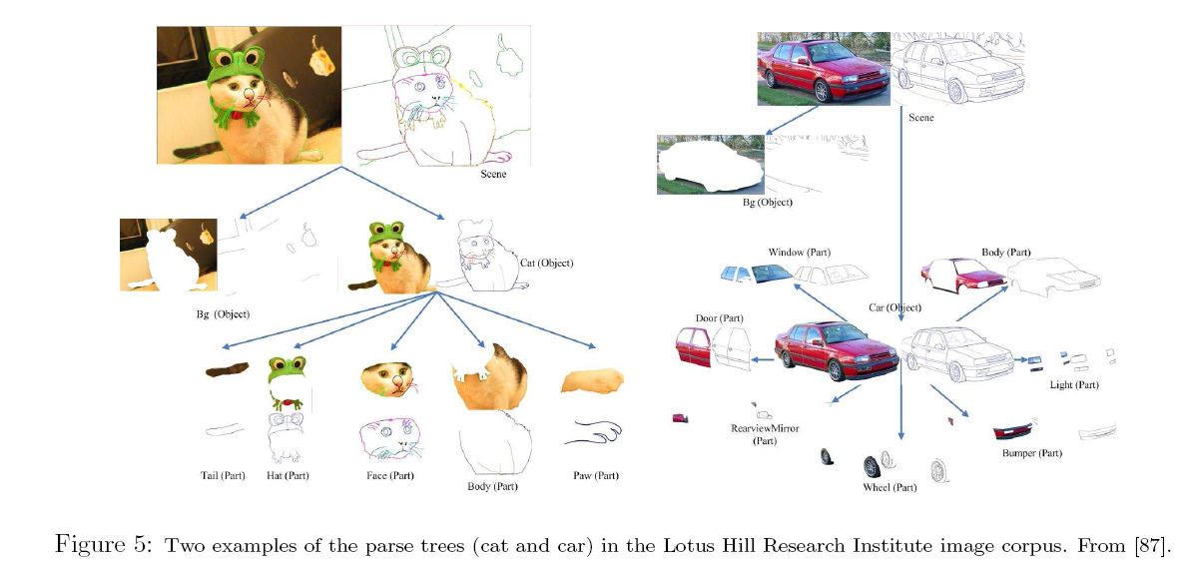
Lotus Hill Research Institute image corpus
Z.Y. Yao, X. Yang, and S.C. Zhu, 2007

Slide 17
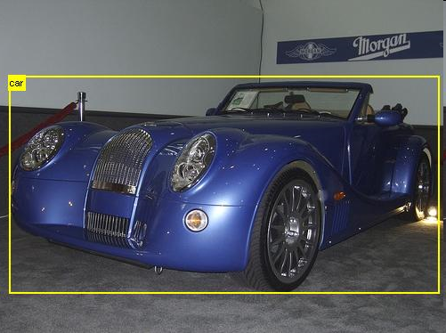
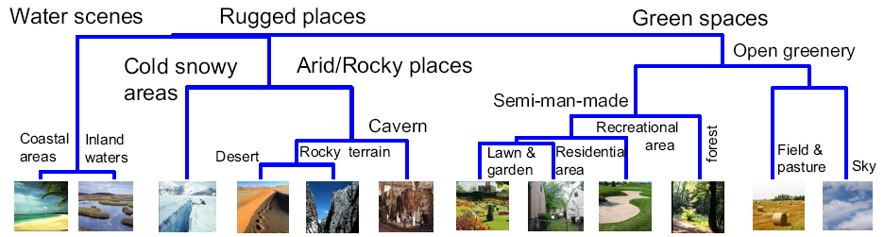
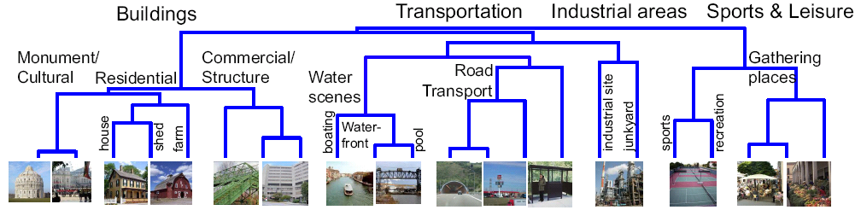
Different datasets Different focuses
5
10
images
PASCAL
Object recognition
Object recognition and localization
Context
Scenes

Slide 18
5
10
images

Slide 19
6-7
10
images
Things start getting out of hand

Slide 20
These datasets start to push the boundaries and ask the question of how many categories are there?
6-7
10
images

Slide 21







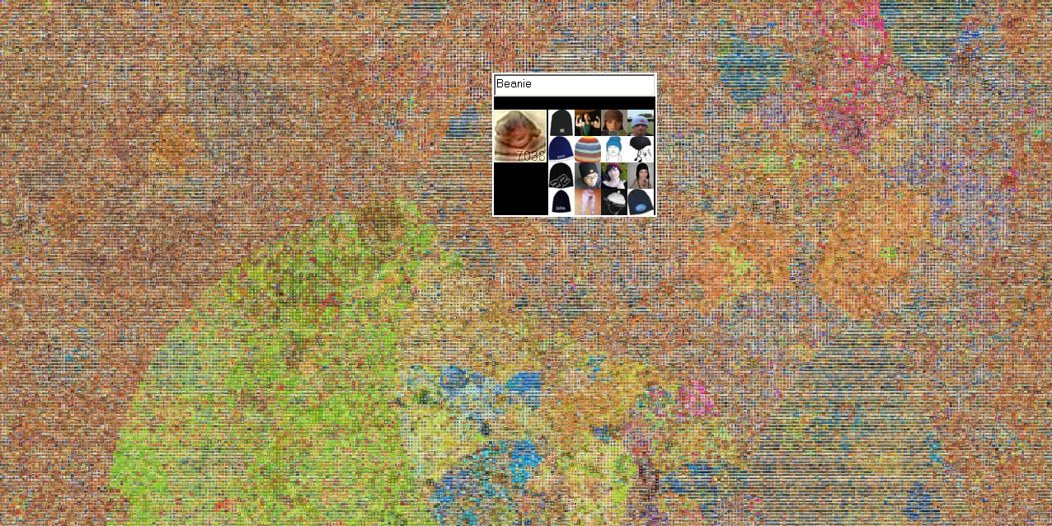
80.000.000 images
6-7
10
75.000 non-abstract nouns from WordNet
7 Online image search engines
images
And after 1 year downloading images
Google: 80 million images
A. Torralba, R. Fergus, W.T. Freeman. PAMI 2008
Notes:
So, we decided to study what happens when we go to infinite

Slide 22



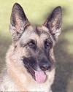
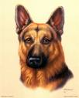
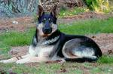
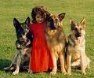
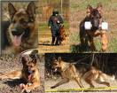
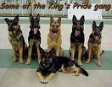
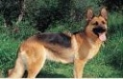
6-7
10
images
An ontology of images based on WordNet
ImageNet currently has
~15,000 categories of visual concepts
10 million human-cleaned images (~700im/categ)
Free to public @ www.image-net.org
~10⁵+ nodes
~10⁸+ images
shepherd dog, sheep dog
animal
collie
German shepherd
Deng, Dong, Socher, Li & Fei-Fei, CVPR 2009

Slide 23
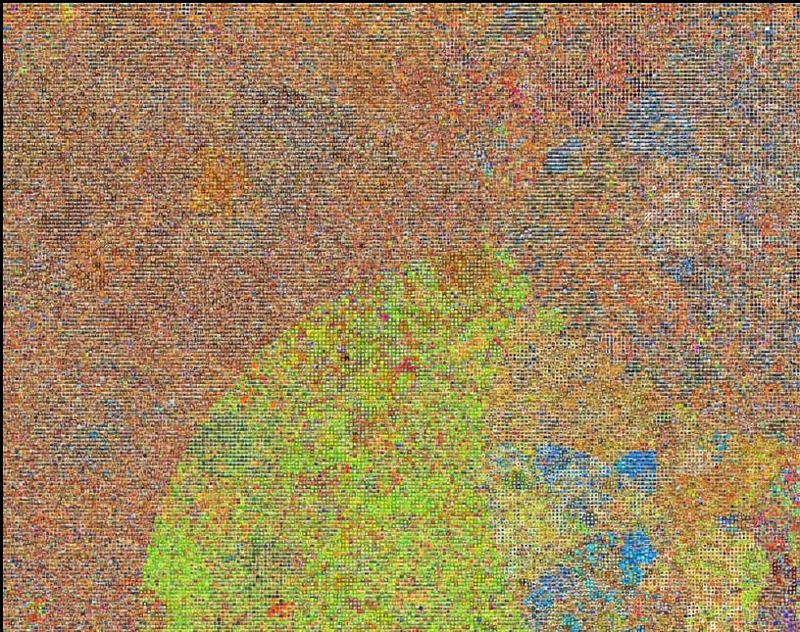
6-7
10
images

Slide 24
8-11
10
images

Slide 25
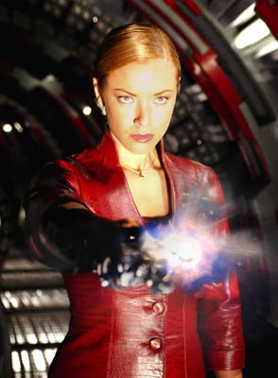
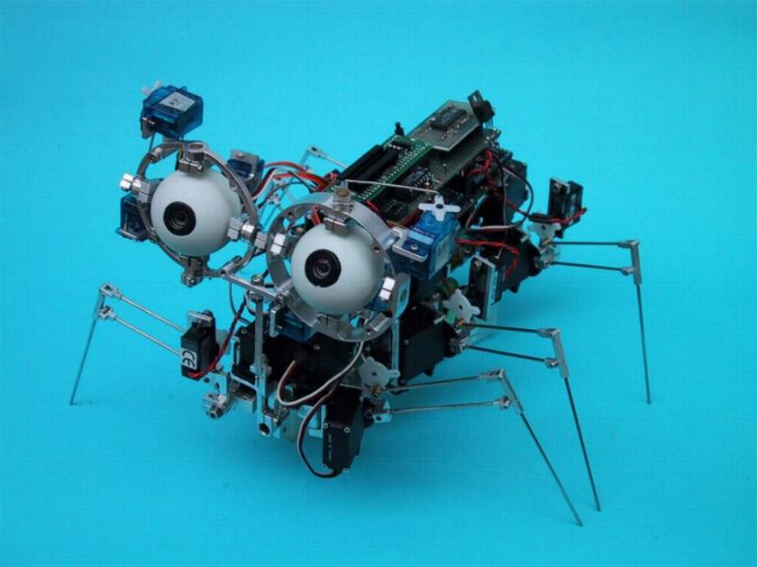
Human vision
Many input modalities
Active
Supervised, unsupervised, semi supervised learning. It can look for supervision.
Robot vision
Many poor input modalities
Active, but it does not go far
Internet vision
Many input modalities
It can reach everywhere
Tons of data
Notes:
But, the real problem is that we wish we had this, (picture robot terminator), but we have this (one of those spiders)

Slide 26

8-11
10
images

Slide 27
8-11
10
images

Slide 28
>11
10
images
?
?
?
?

Slide 29
Dataset size in perspective

Slide 30
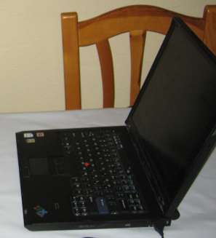
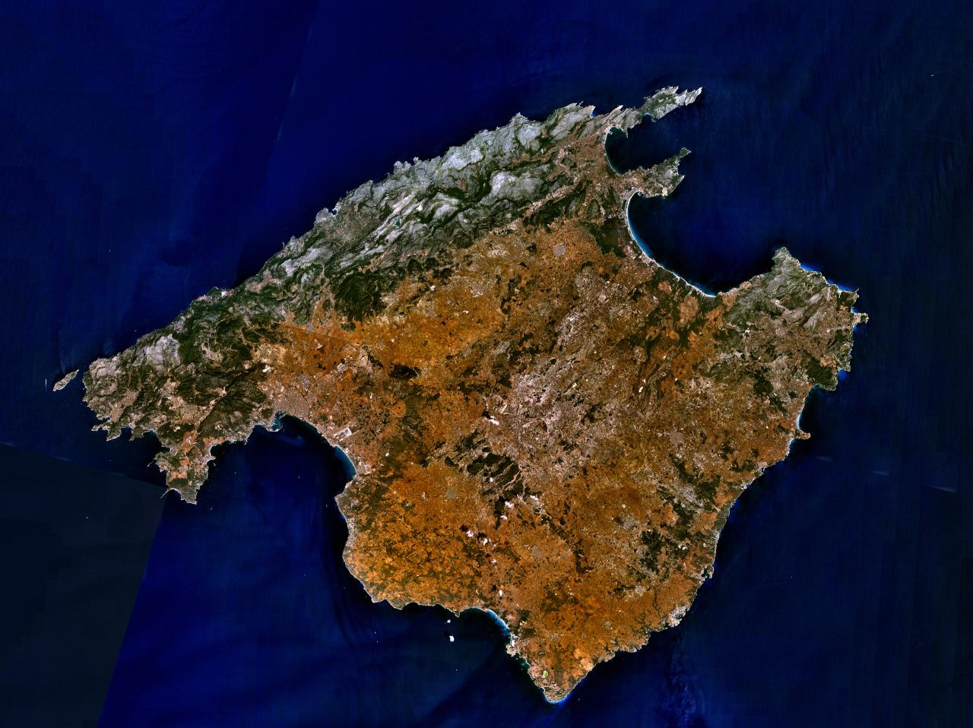

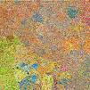
My own powers of 10
Number of images on my hard drive: 10⁴
Number of images seen during my first 10 years: 10⁸
(3 images/second * 60 * 60 * 16 * 365 * 10 = 630720000)
Number of images seen by all humanity: 10²⁰
106,456,367,669 humans¹ * 60 years * 3 images/second * 60 * 60 * 16 * 365 =
1 from http://www.prb.org/Articles/2002/HowManyPeopleHaveEverLivedonEarth.aspx
Number of all 32x32 images: 10⁷³⁷³
256 ^{32*32*3} ~ 10⁷³⁷³

Slide 31
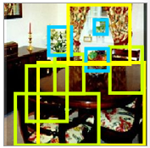
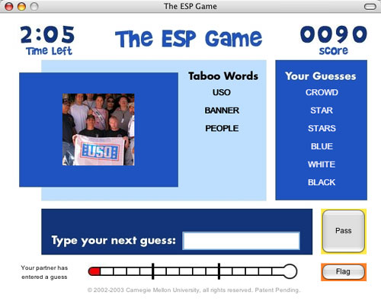



Labeling to get a Ph.D.
Labeling for fun
Labeling for money
Labeling because it gives you added value
Just labeling
Visipedia

Slide 32

Dataset labeling by crowd sourcing

Slide 33
“We've heard that a million monkeys at a million keyboards could produce the complete works of Shakespeare; now, thanks to the Internet, we know that is not true.” -- Robert Wilensky, 1996
A word of warning of crowd sourcing

Slide 34
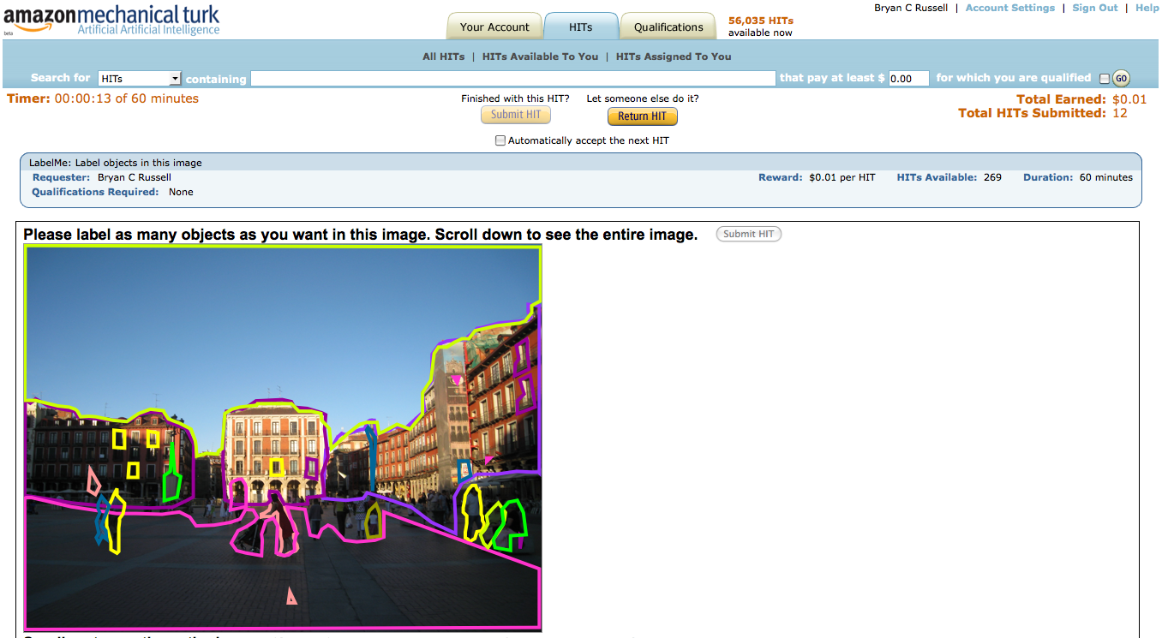
With Bryan Russell

Slide 35
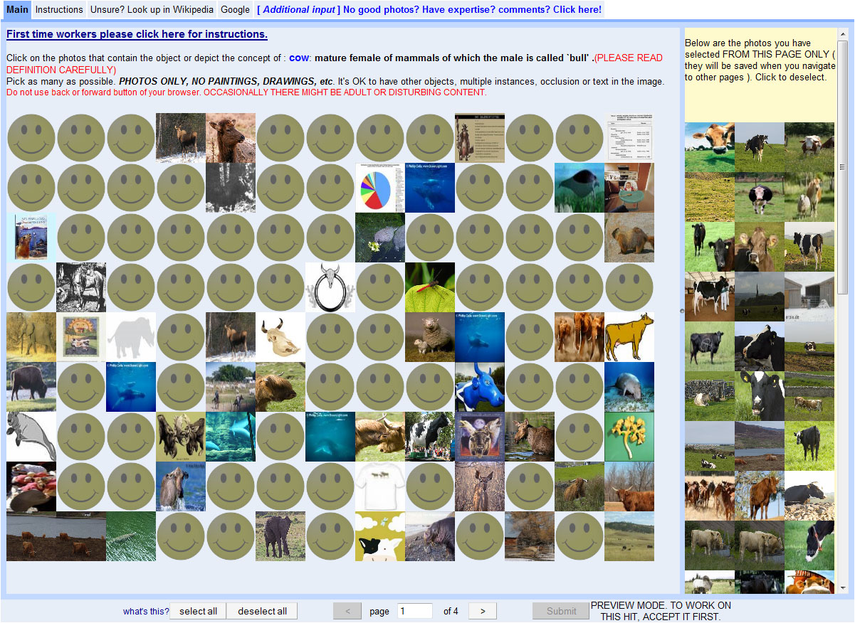
Choose all related images 0.02cent/image

Slide 36
1 cent
Task: Label one object in this image

Slide 37
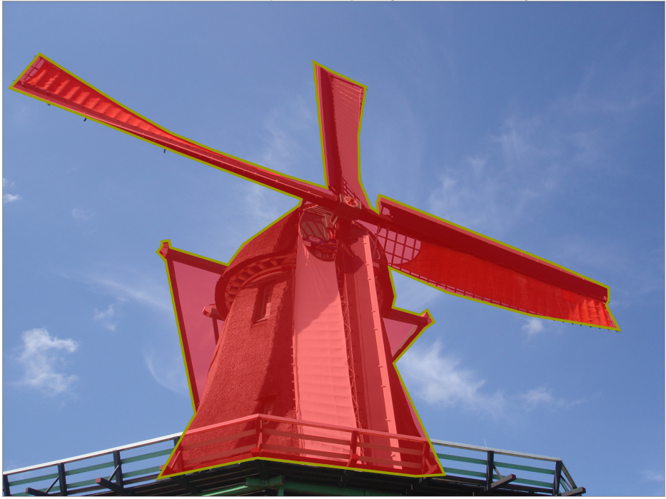
1 cent
Task: Label one object in this image

Slide 38
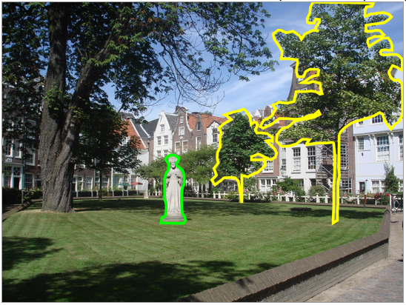
1 cent
Task: Label one object in this image

Slide 39
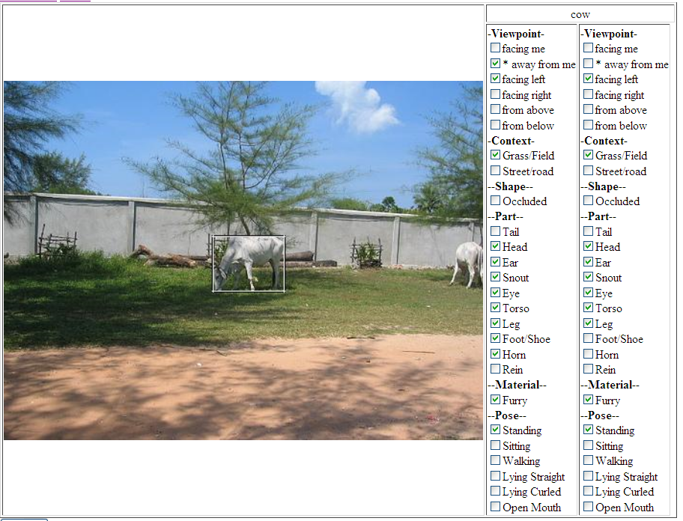
Labeling Attributes
10000+ labelsimages
~500K
$600
Annotator agreement
Agreement among “experts” 84%
Between experts and Turk labelers 81%
Among Turk labelers 84%
[Farhadi Endres Hoiem Forsyth CVPR 2008]
http://vision.cs.uiuc.edu/attributes/

Slide 40
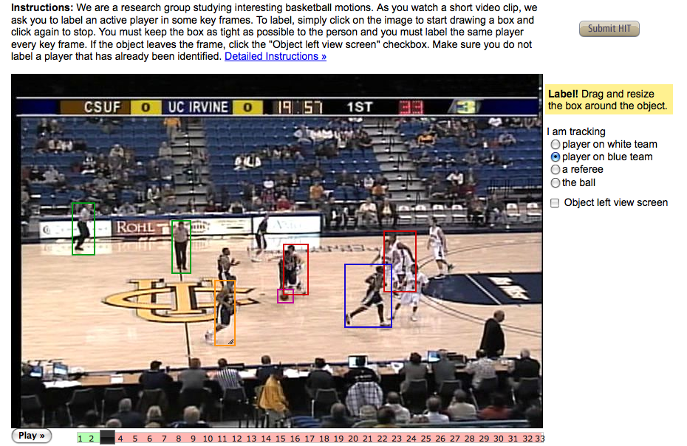
Using Turk to label human activities
Carl Vondrick, Deva Ramanan, Don Patterson
https://workersandbox.mturk.com/mturk/preview?groupId=0YNZVTYH13MZP2ZVKS30

Slide 41
It’s hard task sometimes for 1cent
From: Denise Blah <…@hotmail.com> Fri, Aug 22, 2009 at 8:47 PM
To: Deng Jia @ ImageNet
Hi, Can I ask why you would place images up of certain animals and ask if these animals gender is? […] Example: Tom Cat?? I person cannot tell a cats sex unless they have a image showing between the legs. Sincerely,
Denise

Slide 42
Why people does this?
From: John Smith <…@yahoo.co.in>Date: August 22, 2009 10:18:23 AM EDT
To: Bryan Russell
Dear Mr. Bryan,
I am awaiting for your HITS. Please help us with more.
Thanks & Regards
From: Linda Blah <…@cox.net> Fri, June 12, 2009 at 9:53 AM
To: Deng Jia @ ImageNet
For some strange reason, I really enjoy doing these.

Slide 43
Appreciation from “turkers”
From: Stephanie Blah <…@hotmail.com> Tue, Sep 8, 2009 at 3:19 AM
To: Deng Jia @ ImageNet
Greetings; "Poorly paid labor is inefficient labor, the world over." --Henry George Happy Labor Day

Slide 44
A rough grouping of datasets by usage
Current evaluation benchmarks
Caltech 101/256
PASCAL
MRSC
Resources and ontology
Lotus Hill
LabelMe
Tiny Image
ImageNet

Slide 45

Caltech 101 & 256
Fei-Fei, Fergus, Perona 2004
Griffin, Holub, Perona 2007

Slide 46
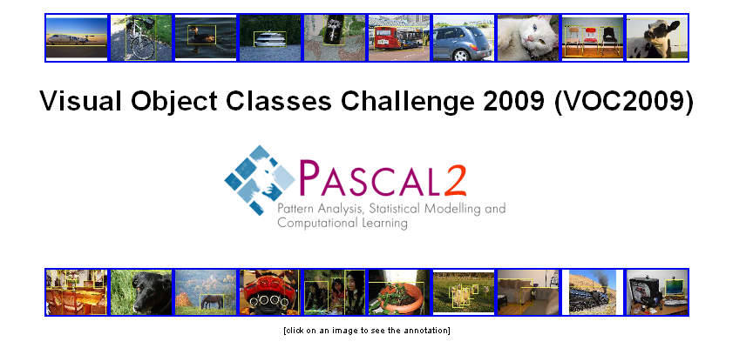
3rd October 2009, ICCV 2009, Kyoto, Japan
M. Everingham, Luc van Gool , C. Williams, J. Winn, A. Zisserman 2007

Slide 47
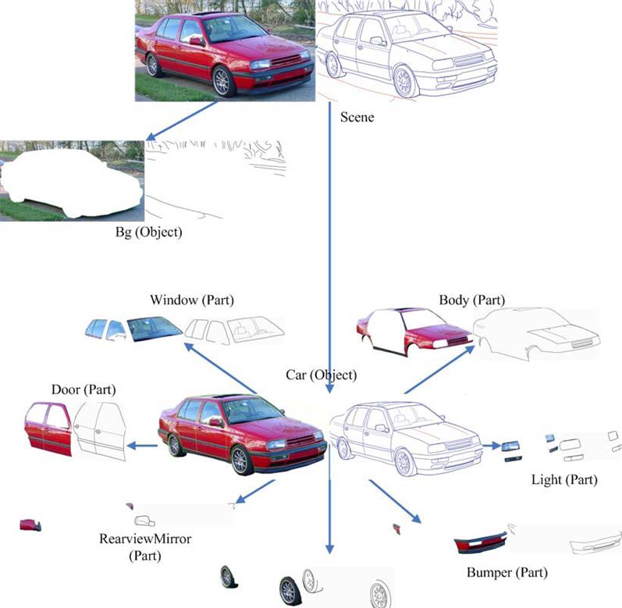
Lotus Hill Dataset
Yao, Liang, Zhu, EMMCVPR, 2007

Slide 48
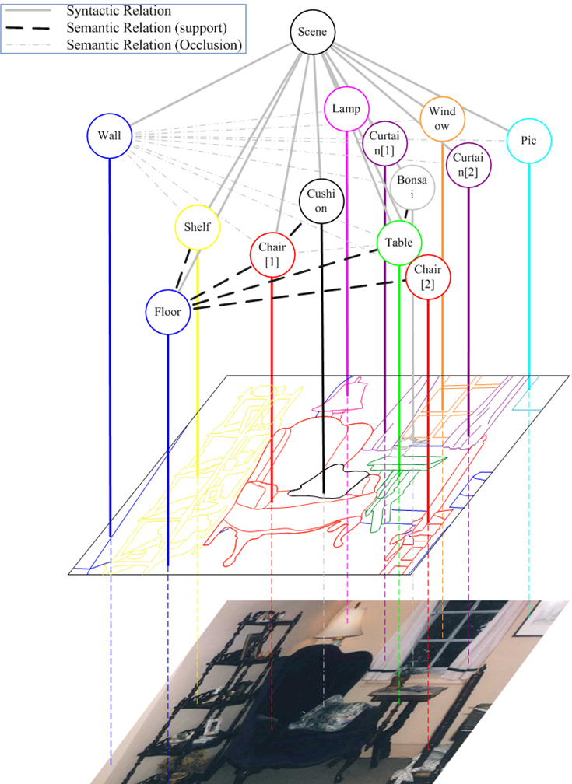
Lotus Hill Dataset
Yao, Liang, Zhu, EMMCVPR, 2007

Slide 49
LabelMe
Russell, Torralba, Freman, 2005

Slide 50
14,847 categories, 9,349,136 images
Sport Activities
Fabric Materials
Instrumentation
Tool
Appliances
…
Plants
…
Animals
Fish
Bird
Mammal
Invertebrate
Scenes
Indoors
Geological formations
Deng, Wei, Socher, Li, Li, Fei-Fei, CVPR 2009

Slide 51
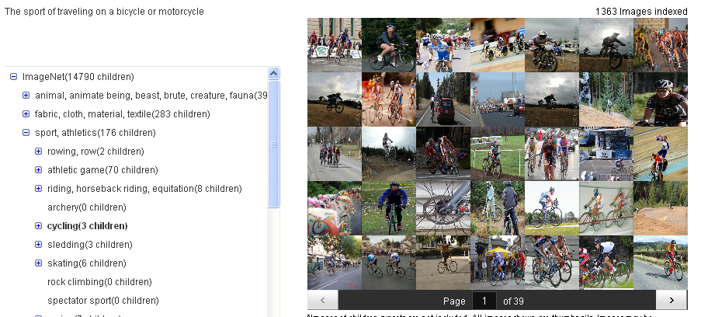
“Cycling”
Deng, Wei, Socher, Li, Li, Fei-Fei, CVPR 2009

Slide 52
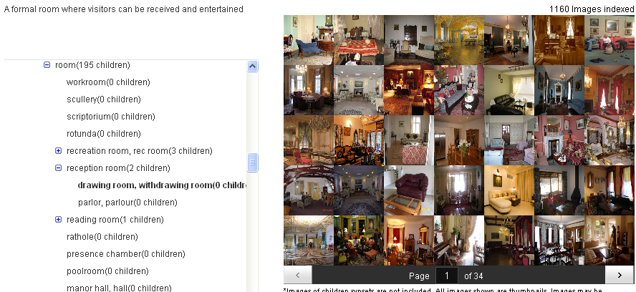
“Drawing room, withdrawing room”
Deng, Wei, Socher, Li, Li, Fei-Fei, CVPR 2009

Slide 53
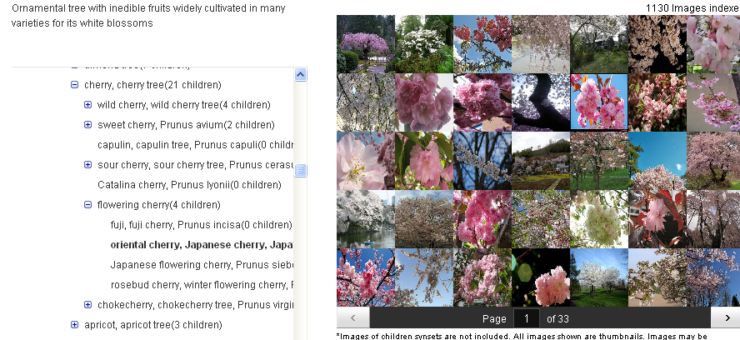
“Oriental cherry, Japanese cherry, Japanese flowering cherry, Prunus serrulata”
Deng, Wei, Socher, Li, Li, Fei-Fei, CVPR 2009

Slide 54
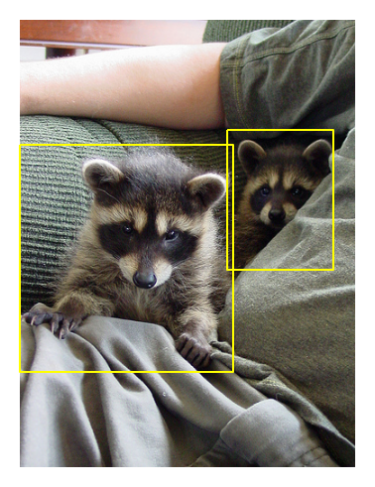
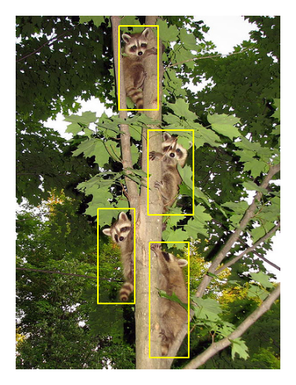




Slide 55
List properties of ideal recognition system
Representation
10…00’s categories,
Handle all invariances (occlusions, view point, …)
Explain as many pixels as possible (or answer as many questions as you can about the object and its environment)
fast, robust
Learning
Handle all degrees of supervision
Incremental learning
Few training images
…

Slide 56



~10,000 to 30,000
PT = 500ms
Biederman, 1987
Some kind of game or fight. Two groups of two men? The foregound pair looked like one was getting a fist in the face. Outdoors seemed like because i have an impression of grass and maybe lines on the grass? That would be why I think perhaps a game, rough game though, more like rugby than football because they pairs weren't in pads and helmets, though I did get the impression of similar clothing. maybe some trees? in the background. (Subject: SM)
Fei-Fei, Iyer, Koch, Perona, JoV, 2007

Slide 57

http://people.csail.mit.edu/torralba/shortCourseRLOC/

